Slide 1
React.js

Slide 2
What is React.js
It’s a javascript library!

Slide 3
What is React.js use for?
To build user interfaces!

Slide 4
Why React.js?
Fast learning curve

Slide 5
Why React.js?
Reusable components

Slide 6
Why React.js?
Faster rendering using Virtual DOM

Slide 7
Why React.js?
Clean Abstraction

Slide 8
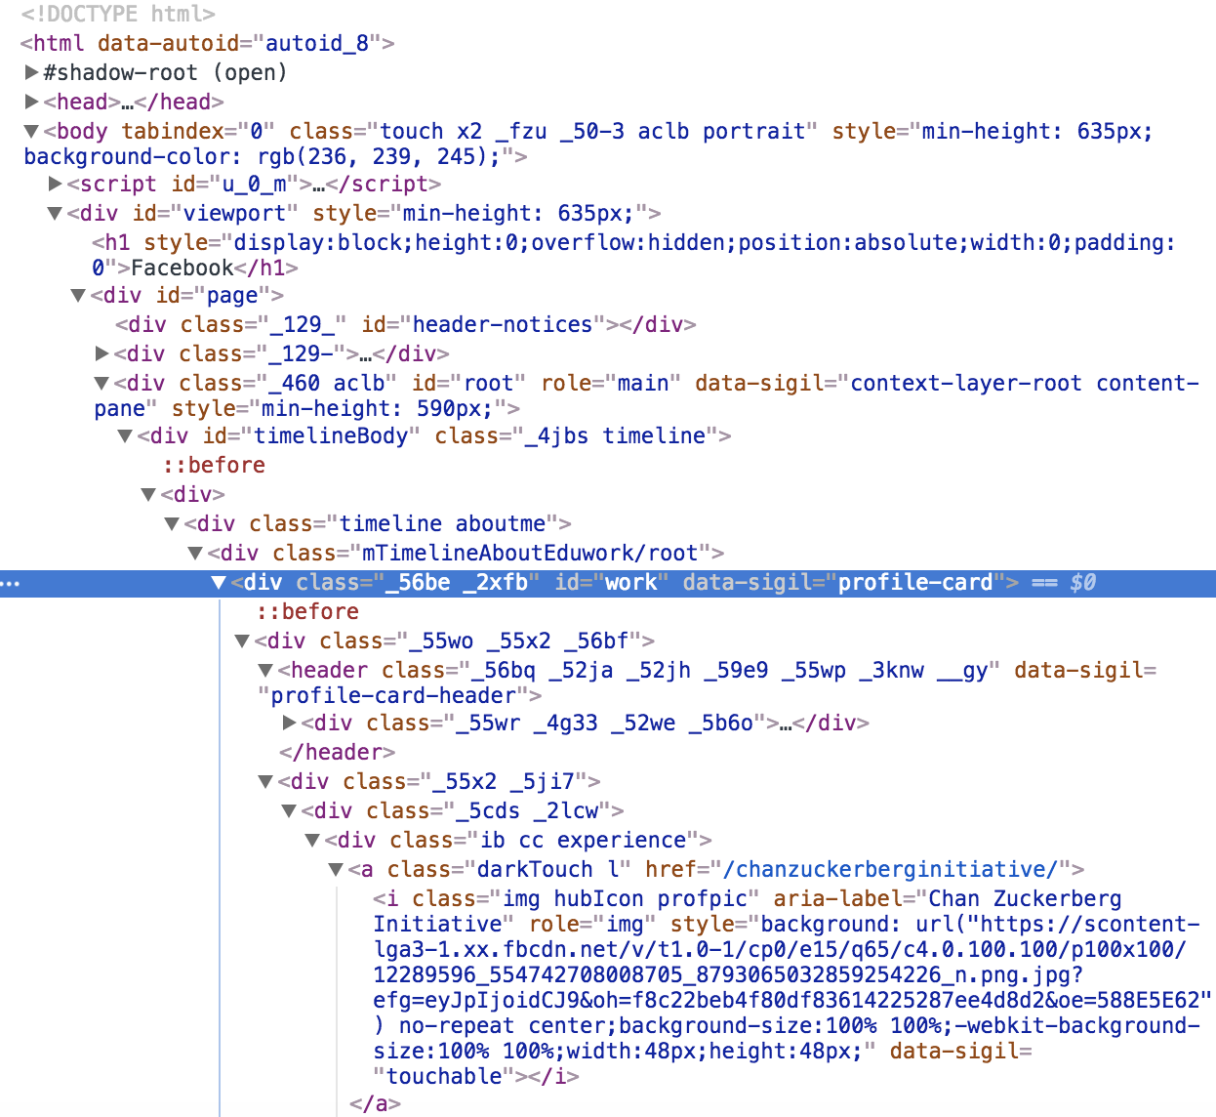
Why React.js?

Slide 9
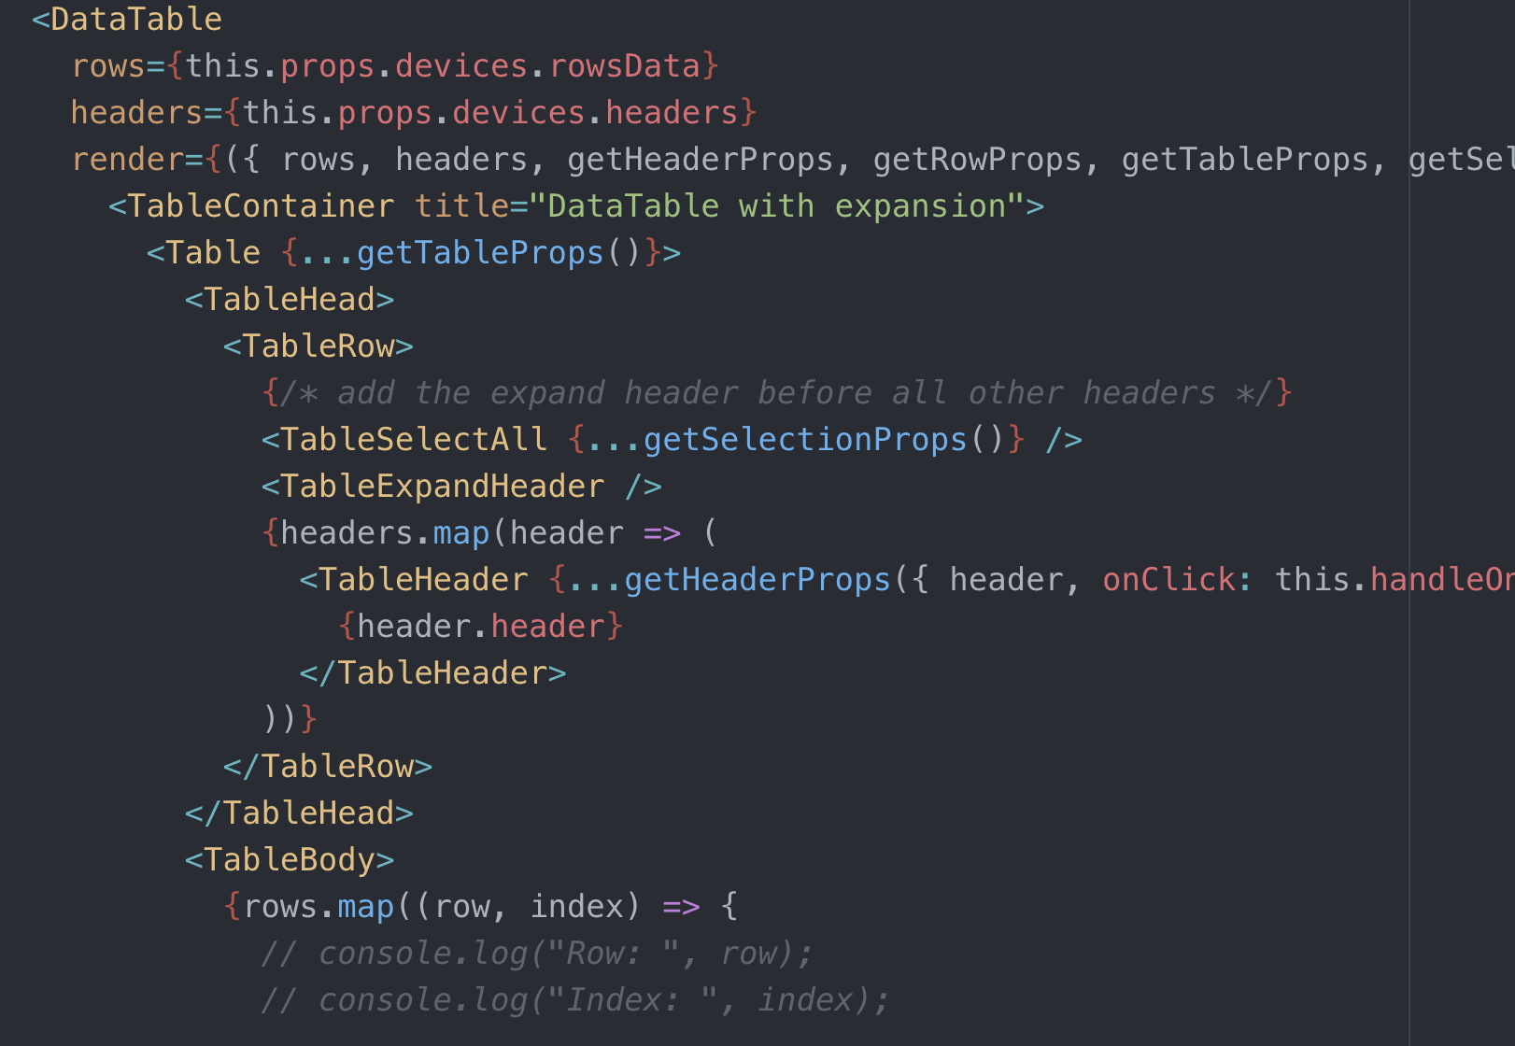
Why React.js?

Slide 10
Lets create the clichéd “Hello, world!”
Visit codepen.io
Add react library
Add react-dom library
Change js preprocessor to babel
Notes:
Hands on, type it out.

Slide 11
Lets create the clichéd “Hello, world!”
https://reactjs.org/redirect-to-codepen/hello-world

Slide 12
Lets create the clichéd “Hello, world!”
ReactDOM.render(
<h1>Hello, world!</h1>,
document.getElementById('root')
);

Slide 13
Dynamic content delivery

Slide 14
For tightly coupled user experience

Slide 15
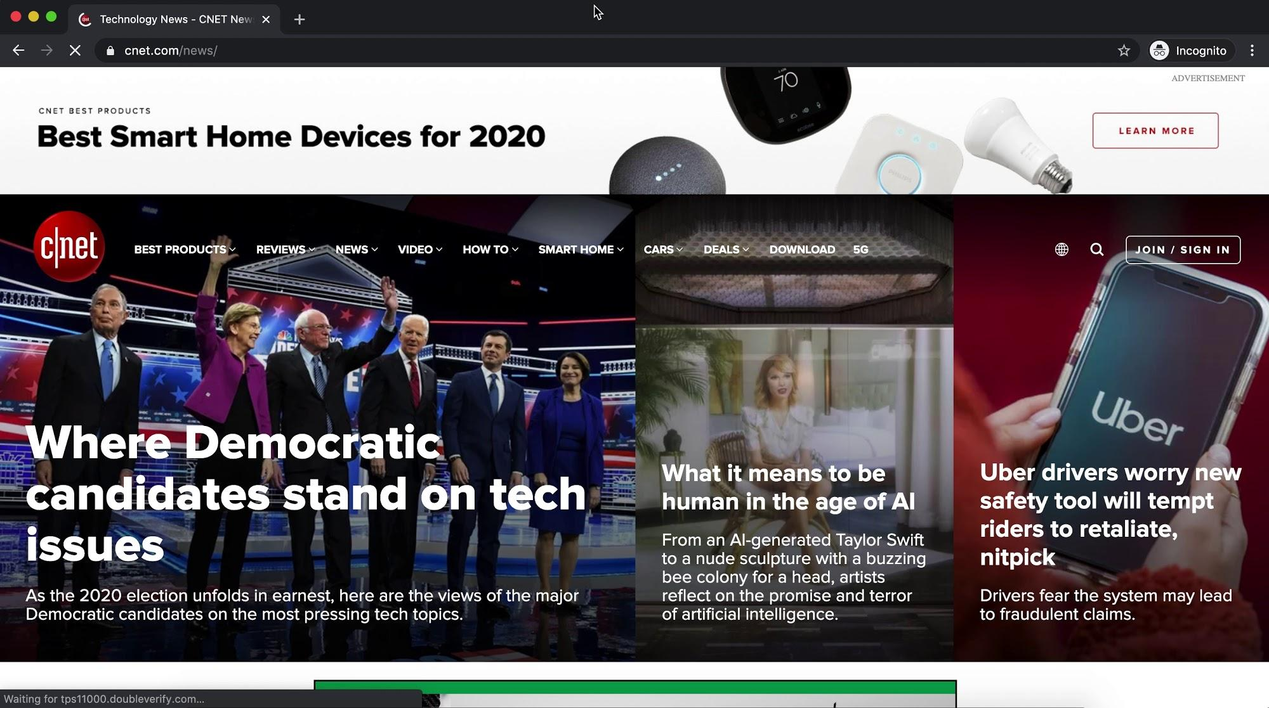

Slide 16
Blog post website scenario

Slide 17
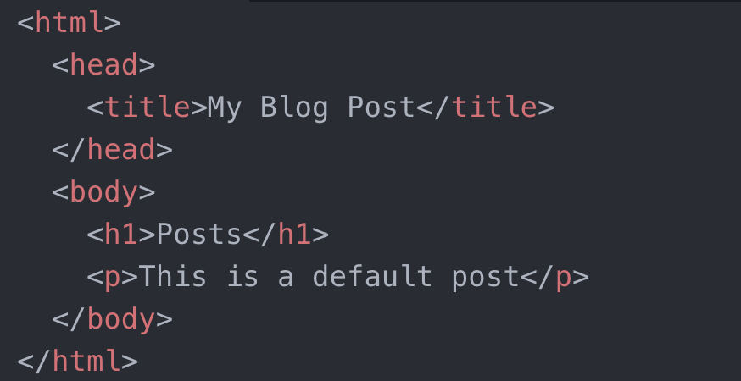

Slide 18
Browser view of our minimalist website!

Slide 19
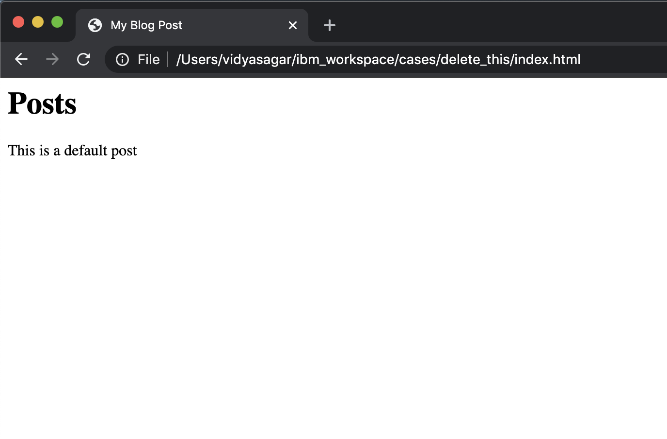

Slide 20
HTML’s DOM (Document Object Model)
Document “Root”
<html>
Element
<head>
Element
<body>
Element
<title>
Element
<h1>
Element
<p>
Text Node
“My Blog Post”
Text Node
“Recent Blogs”
Text Node
“Default blog text”

Slide 21
HTML’s DOM (Document Object Model)
Lets add a post that is fetched dynamically from a database,
shall we??????
Document “Root”
<html>
Element
<head>
Element
<body>
Element
<title>
Element
<h1>
Element
<p>
Text Node
“My Blog Post”
Text Node
“Recent Blogs”
Text Node
“Default blog text”

Slide 22
Fetch a new post
response = getMyPost(“https://myblogapi.google.com/latestpost”);

Slide 23
HTML’s DOM (Document Object Model)
Document “Root”
<html>
Element
<head>
Element
<body>
Element
<title>
Element
<h1>
Element
<p>
Text Node
“Dynamically generated blog text”
Text Node
“My Blog Post”
Text Node
“Recent Blogs”
Text Node
“Default blog text”

Slide 24
Create a paragraph element in javascript
response = getMyLatestPost(“https://api.myblogs.google.com/latestpost”);
var newPost = document.createElement("p");

Slide 25
HTML’s DOM (Document Object Model)
Document “Root”
<html>
Element
<head>
Element
<body>
Element
<title>
Element
<h1>
Element
<p>
Element
<p>
Text Node
“Dynamically generated blog text”
Text Node
“My Blog Post”
Text Node
“Recent Blogs”
Text Node
“Default blog text”

Slide 26
Fill the para with our dynamically fetched post
response = getMyLatestPost(“https://api.myblogs.google.com/latestpost”);
var newPost = document.createElement("p");
newPost.innerText = response.text;

Slide 27
HTML’s DOM (Document Object Model)
Document “Root”
<html>
Element
<head>
Element
<body>
Element
<title>
Element
<h1>
Element
<p>
Element
<p>
Text Node
“Dynamically generated blog text”
Text Node
“My Blog Post”
Text Node
“Recent Blogs”
Text Node
“Default blog text”

Slide 28
Add our new post to the body of HTML
response = getMyLatestPost(“https://api.myblogs.google.com/latestpost”);
var newPost = document.createElement("p");
newPost.innerText = response.text;
document.body.appendChild(newPost);

Slide 29
HTML’s DOM (Document Object Model)
Document “Root”
<html>
Element
<head>
Element
<body>
Element
<title>
Element
<h1>
Element
<p>
Element
<p>
Text Node
“Dynamically generated blog text”
Text Node
“My Blog Post”
Text Node
“Recent Blogs”
Text Node
“Default blog text”

Slide 30
Exercise: Add a dynamic post to our blog
Notes:
All code: /Users/vidyasagar/ibm_workspace/cases/delete_this
Code for this exercise:
/Users/vidyasagar/ibm_workspace/cases/delete_this/add_post_to_blog.js
/Users/vidyasagar/ibm_workspace/cases/delete_this/index.html

Slide 31
Now we know:
How DOM works
How to create an element in DOM

Slide 32
Lets create our own React.js spinoff library

Slide 33
v1
Notes:
All code: /Users/vidyasagar/ibm_workspace/cases/delete_this
Code for this exercise:
/Users/vidyasagar/ibm_workspace/cases/delete_this/v1.js

Slide 34
v2
Notes:
All code: /Users/vidyasagar/ibm_workspace/cases/delete_this
Code for this exercise:
/Users/vidyasagar/ibm_workspace/cases/delete_this/v2.js

Slide 35
REACT
BABEL
Our
Spinoff
Notes:
All code: /Users/vidyasagar/ibm_workspace/cases/delete_this
Code for this exercise:
/Users/vidyasagar/ibm_workspace/cases/delete_this/v1.js

Slide 36
React & Babel

Slide 37
Babel -> JavaScript transcompiler

Slide 38
Lets write our own Transcompiler similar to Babel?

Slide 39
Just change <h1> to h1(“

Slide 40
And change </h1> to “)

Slide 41
render(<h1>Hello, world</h1>);
becomes
render(h1(“Hello, world”));

Slide 42
The clichéd “Hello, world!”
ReactDOM.render(
<h1>Hello, world!</h1>,
document.getElementById('root')
);

Slide 43
Optional activity: Transcompile some JSX on https://babeljs.io

Slide 44
Do we now know what React, Babel, JSX are?

Slide 45
Styles in JSX

Slide 46
Simply replace class with className in your HTML looking JSX

Slide 47
React.js example stage2

Slide 48
Props in React.js

Slide 49
I have a DataTable on my web app.
How do I pass data to the DataTable?

Slide 50
React.js example stage3

Slide 51
Lets Build something?

Slide 52
Comment Posts App

Slide 53
Class based components??

Slide 54
Thanks, no thanks???

